Slide 1
Attack of the Clichés/Tropes
By Robert Graham

Slide 2
About me
BlackICE
First IPS (intrusion prevention system)
Sidejacking
Masscanning
I talk a lot at conferences
I blog
Notes:
Not so well know that you should know who I am, but enough known that you probably do.

Slide 3
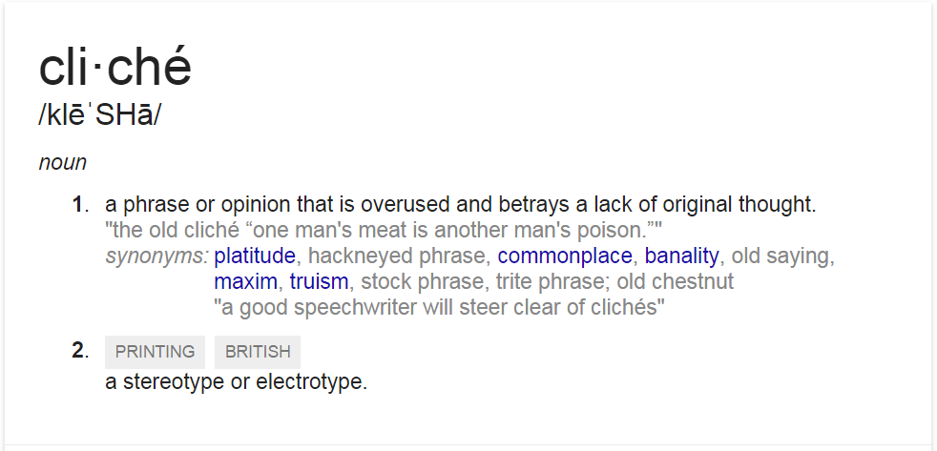
Notes:
“lack of original thought”
“platitude”

Slide 4

Notes:
Self explanatory. There are zillions of tweets just like this is you google “Be different and you’ll always stand out”

Slide 5
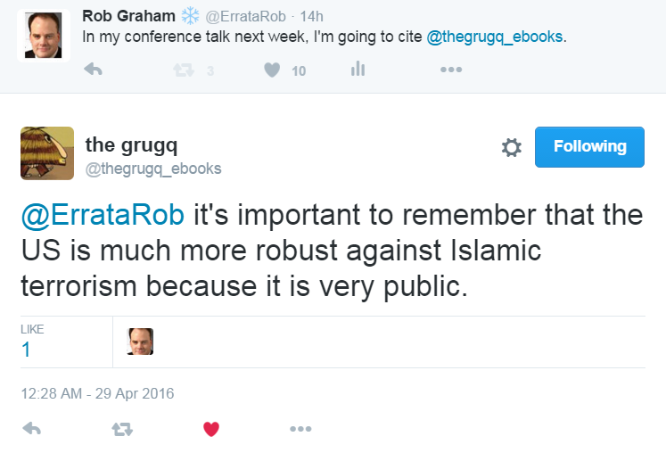
Notes:
If you can’t think originally, you’ll be replaced by a chatbot some day.

Slide 6
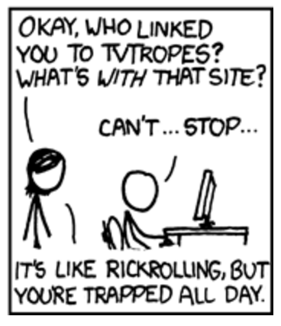
Notes:
Tropes are like clichés, but they are more literary story elements than quotes. It’s like how Luke Skywalker wore white and Darth Vader wore black, so we knew who the good/bad guys were.
Tropes shape discourse. Whatever we want to discuss, we end upmorphing the subject into a well known trope.

Slide 7
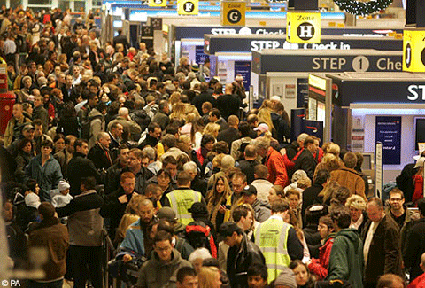
Thanksgiving: The Busiest Flying Day of the Year
Notes:
An example of the power of tropes is the story of how the day before thanksgiving is the busiest travel day of the year.
Local TV crews head to the nearest airport can point their cameras as the busiest part.

Slide 8
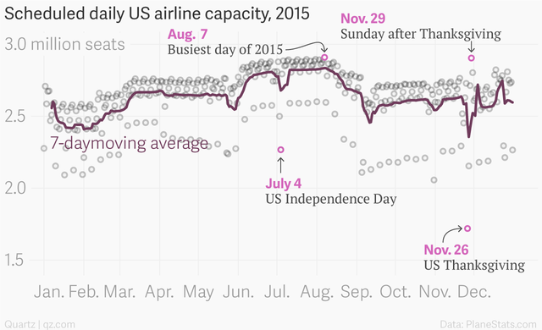
Notes:
http://qz.com/545014/the-day-before-thanksgiving-is-not-the-busiest-day-to-fly-in-the-us/

Slide 9
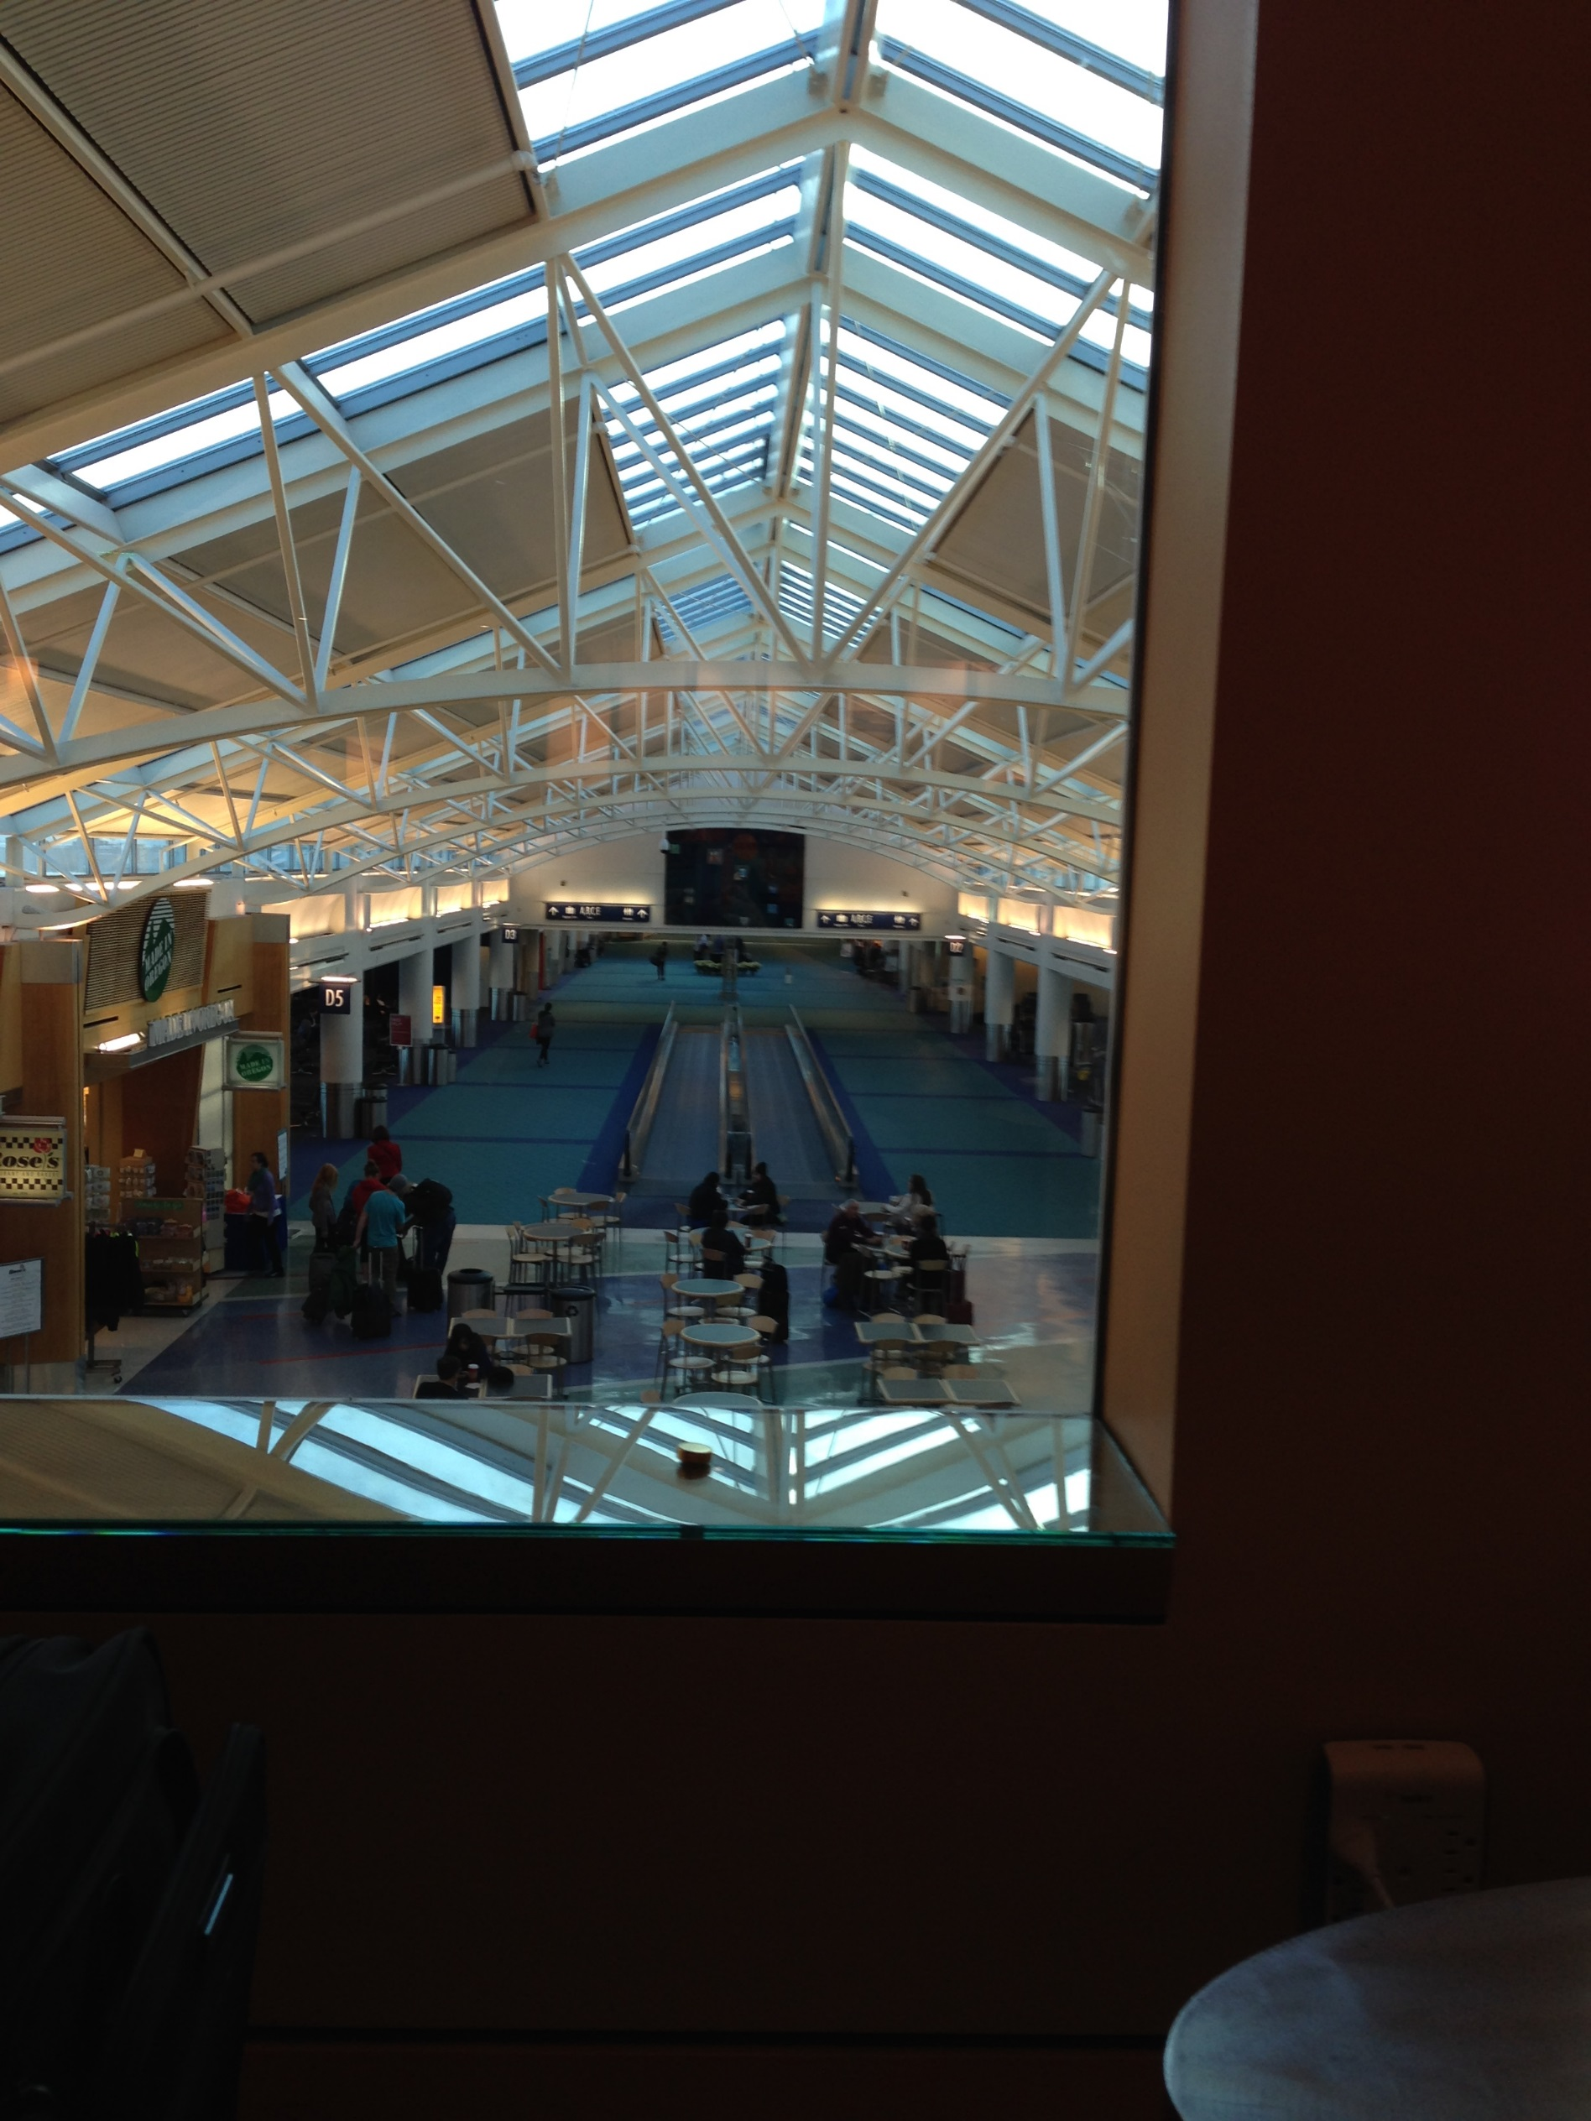
Notes:
I took this on the Sunday after Thanksgiving. Notice how the airport isn’t crowded at all.

Slide 10
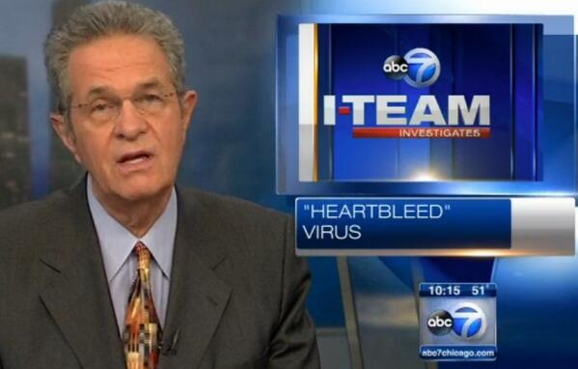
Notes:
“Heartbleed virus”
Notice how the power of tropes morphs the actual facts they don’t know into something they understand, viruses.

Slide 11
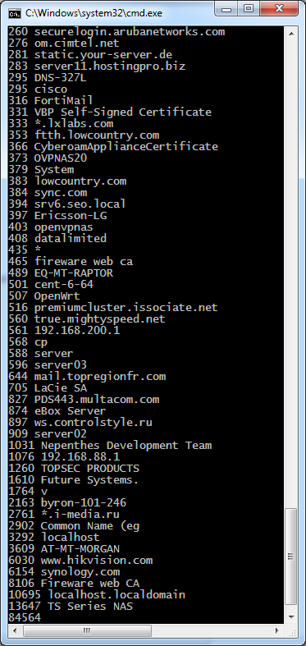
How many are still vulnerable to Heartbleed?
Notes:
The trope is “how many web servers on the internet”.
The answer is an insignificant number, but that 300,000 non-server devices, such as NAS boxes and cameras, are vulnerable. The trope is the wrong question to ask: any important server is patched.

Slide 12
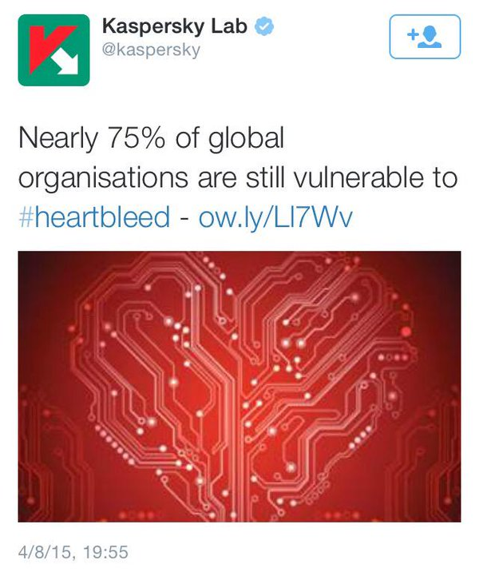
Bad data is bad
Notes:
This was a story based on nonsense data. It’s impossible to measure.
But the trope demands that we count.

Slide 13

“Military grade encryption”
Notes:
We know this cliché is nonsense. The military has no grade of encryption that the people have. If you understood encryption, you’d know this.

Slide 14
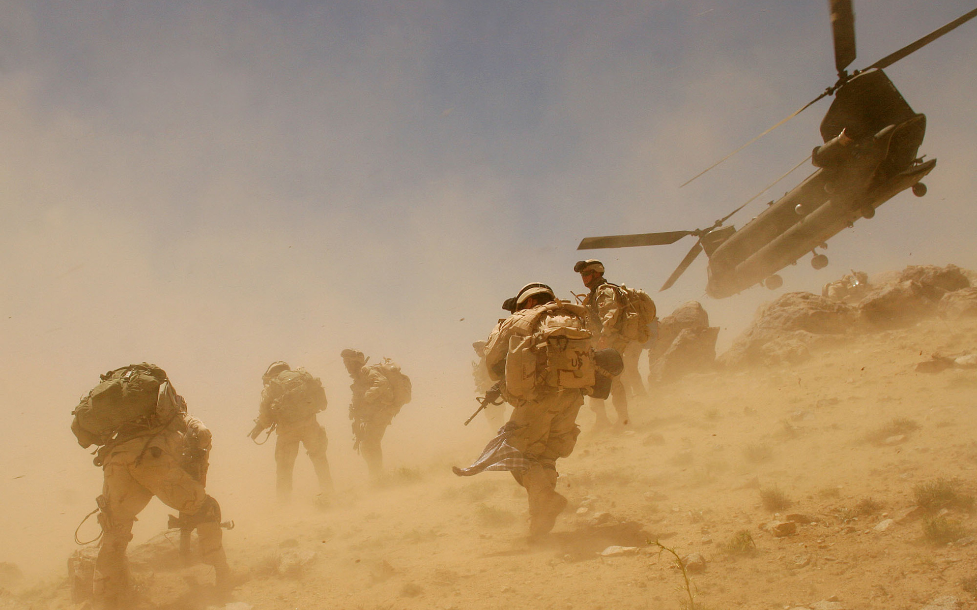
Notes:
…but also, that’s not what “military grade” means. Military grade is something that works in the hands of panicing, poorly trained soldiers, in the heat of battle, in the heat of the desert.

Slide 15

“Defense in Depth”
Notes:
This cliché doesn’t mean what we think it means.
Notice the castle. The strongest part is the keep in the center. Then strong walls. The weaker walls. Then a mote.
The principle is not to put the strongest defenses on the outside, but to make the outer defenses weak, but overcomable barrier.

Slide 16
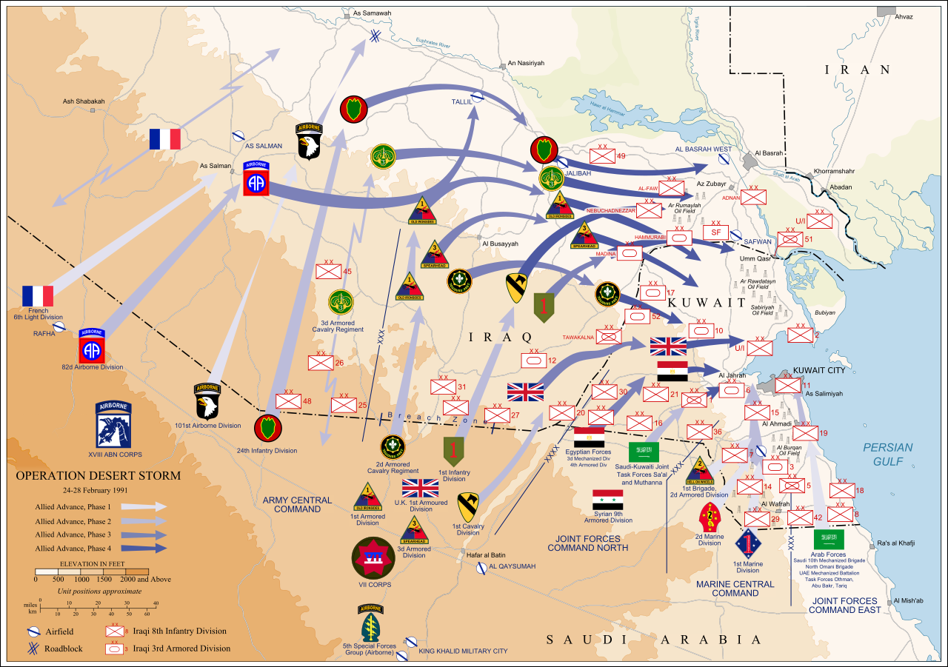
Notes:
Countries practice the same principle. They put their troops on the inside of their country, not on the borders. Instead of a sneak attack that wipes out the army, invaders must first signal their intentions by crossing the border.
In the first gulf war, Iraq didn’t do this. This allowed the US to invade from behind, and cut off troops.

Slide 17
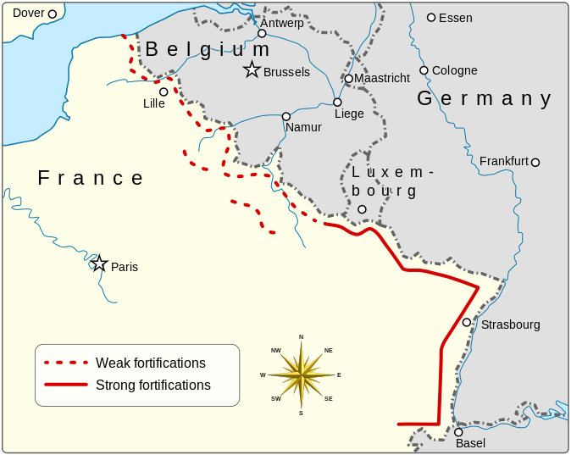
Notes:
Same thing happened in WW II with France’s Maginot Line. The Germans simply went where the French strength’s weren’t. Had the French fortifications been deeper in the country, they would’ve made more of a difference.
The point isn’t what Iraq/France should’ve done. The point is that “defense in depth” is a cliché that ignores the reality. Used correctly, it means weak defenses on the borders, and strong defense inside.

Slide 18
Internet
Office
BYOD
Servers
Notes:
If we were serious about the original meaning of “defense in depth”, we do things this way. We’d treat the office network as an external, hostile network, with few protections form the Internet. We’d focus the majority of our defenses on protecting the servers from the desktops.
Which, btw, needs to happen anyway. We still haven’t solved phishing, so desktops should be considered “outside the firewall” anyway.
This also solves the BYOD problem, as devices are no more “inside” the network than destops. Stop worrying about securing the devices – focus on securing the servers from the devices.

Slide 19
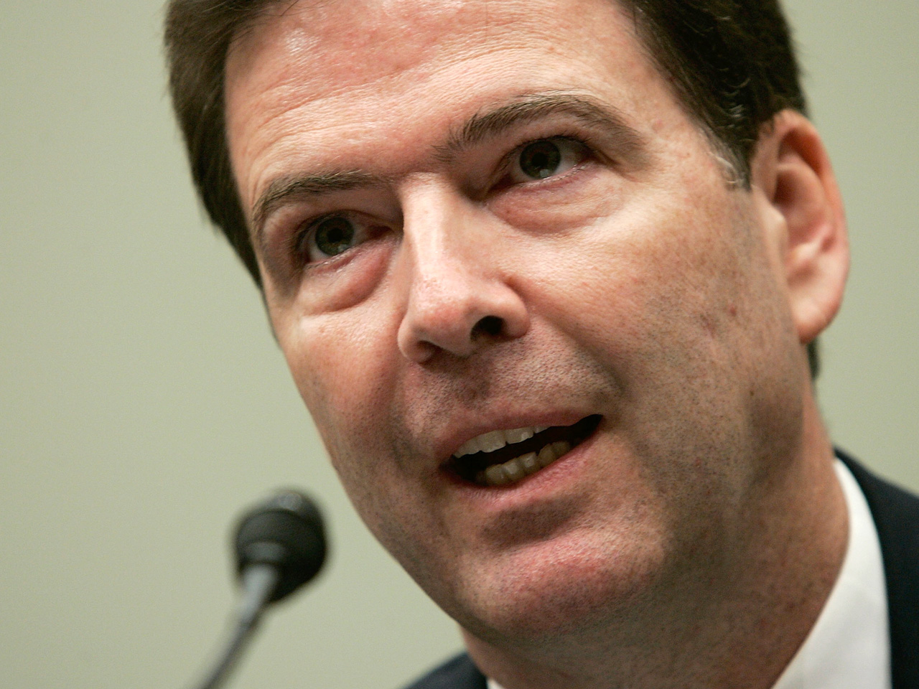
I need it in order to do my job
Without it, I can’t do my job
Notes:
FBI Directory James Comey makes this statement about crypto backdoors, that they’ll “go dark”. It’s a lie – this have increasing evidence about citizens every year, from license plate readers, to face recognition, to GPS tracking, to credit card receipts, to everything.
It’s hyperbole. It’s a lie. We make it all the time to convince superiors to buy toys for us to play with.

Slide 20
decreasing marginal returns
Notes:
Such arguments are never either/or. How well you do your job is a curve. The toy may make your job marginally easier, or marginally harder if you don’t have it.

Slide 21
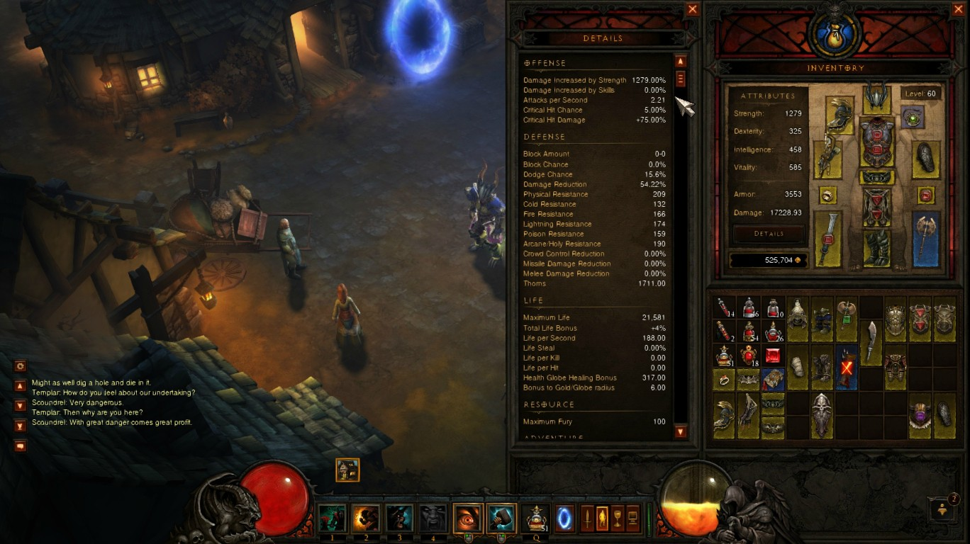
Notes:
If you play Diablo III, and pay attention to the mechanics, you are familiar with the decreasing marginal returns of stats.

Slide 22
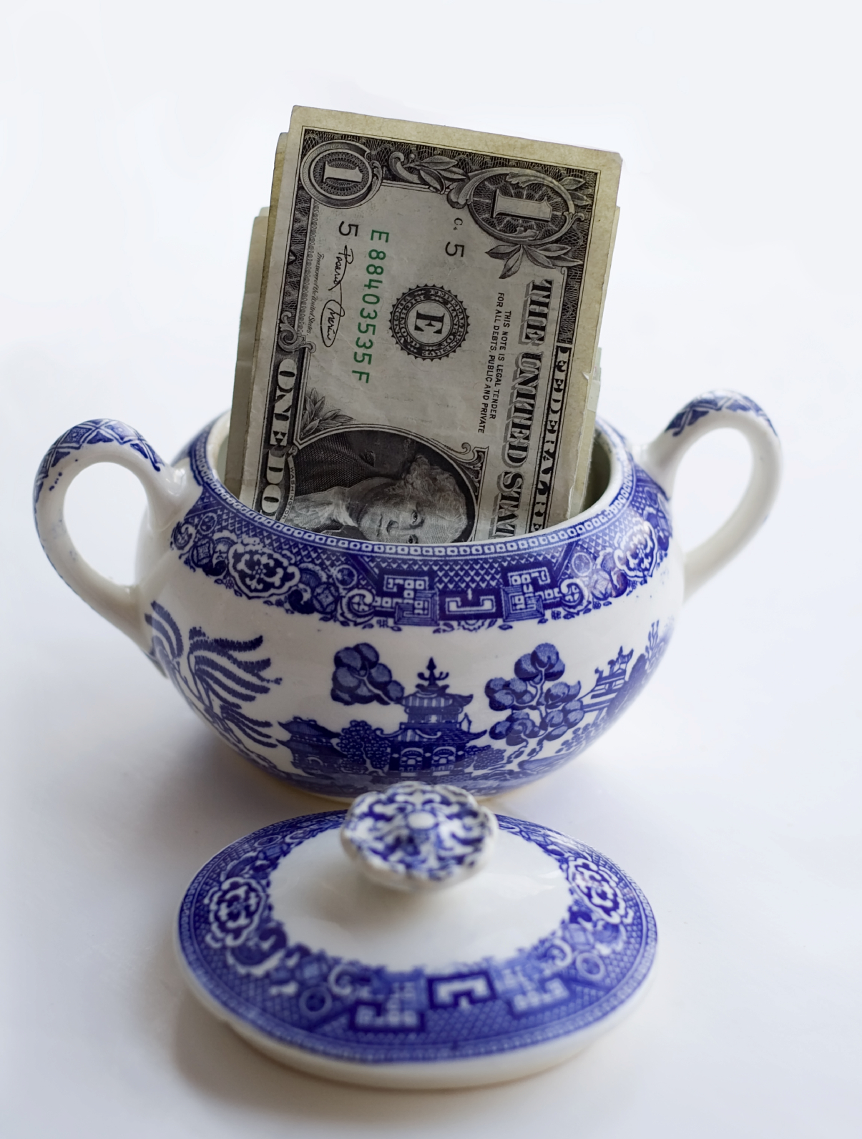
Trope: That Hidden Coffee Slush Fund
Notes:
This leads to the trope “The Hidden Coffee Fund”.
You look at your tasks, and see that there’s one thing that will get you over a hurdle if you could just expand your budget by a little bit. You go to your boss and ask for the money. After all, this is really important. You are certain that there some money lying around somewhere that’s not being used for anything important, that can be use for this.
Everyone did this. When I was a lower level engineer, I did this. Then I became the boss and saw things from the opposing point of view. I knew there was no slush fund sitting around – all the money was budgeted for important things. Yet, everyone kept coming to me for this extra money, believing their job was important, and whatever the money was being used for was not important.
This is a big ying-yang inside our companies. Everyone is looking for some angle to squeeze money out of their bosses. And bosses are looking for ways to fair judge actual importance in this toxic political atmosphere.
It’s a trope because of the way it molds people’s thinking. Whatever you think the argument actually is, it comes down to arguing for access to the hidden coffee slush fund.

Slide 23

Talk in Business Terms like “ROI”
Notes:
First of all, there’s no ROI for security. It doesn’t apply. No matter how we torture, it trying to make it relevant, such as “ROSI”, it still doesn’t work.
The reason the business types aren’t listening is because they know that what you are really arguing is the Coffee Slush Fund trope anyway. And they are laughing at you, because you are trying to use terms you really don’t understand, thinking you are talking in their language.
Learn their language, so that you can understand what they mean. But talk in your own language, and educate them on your own language.

Slide 24
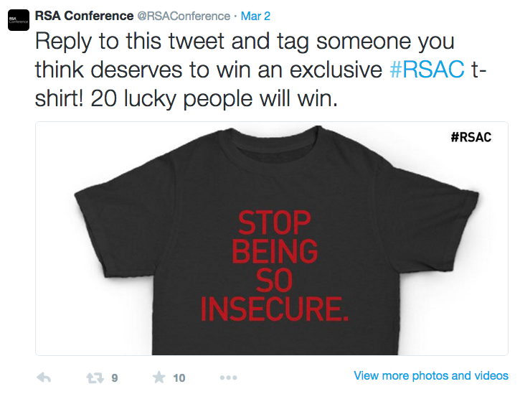

Slide 25
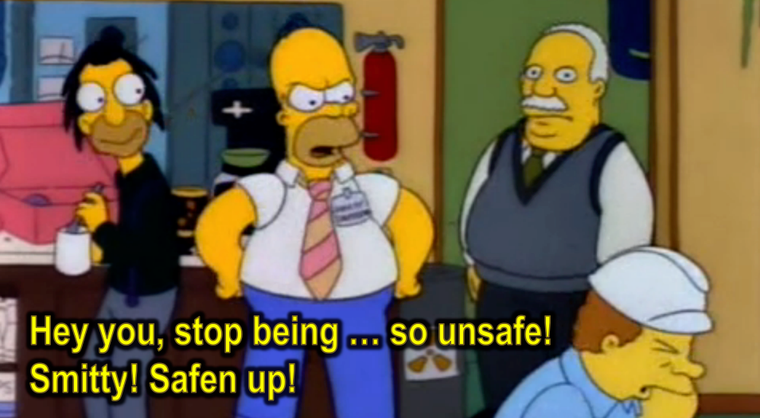
Notes:
Our field is full of “Security Homers”: people who don’t know anything, and thus have no technical authority. But they know security is a moral duty, which gives them the moral authority to tell people to “safen up”.

Slide 26
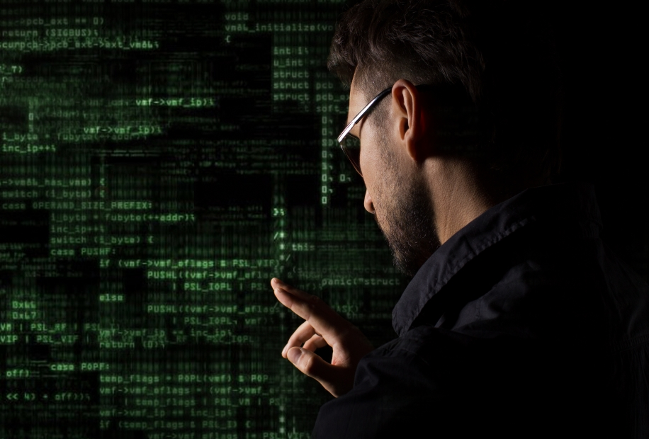
Hackers are sophisticated
Notes:
Whenever somebody gets hacked, their PR spokesperson says it was a “sophisticated” attack. Obviously, because it was unsophisticated, it’d mean they were idiots.
But attacks are almost always phishing, SQL injection, and password reuse – wholly unsophisticated attacks that teenagers do.
Unless you are talking about Stuxnet, there’s never a reason to use the word “sophisticated”. When you see it, you see spin.

Slide 27

Notes:
We’ve all seen this. I guess it’s a cliché all by itself, but a truthful one: attacks are usually unsophisticated.

Slide 28

“Many eyes makes bugs shallow”
Notes:
Heartbleed was found by fuzzing, not by code review.
There appears to be little difference in buginess between open and closed source.

Slide 29
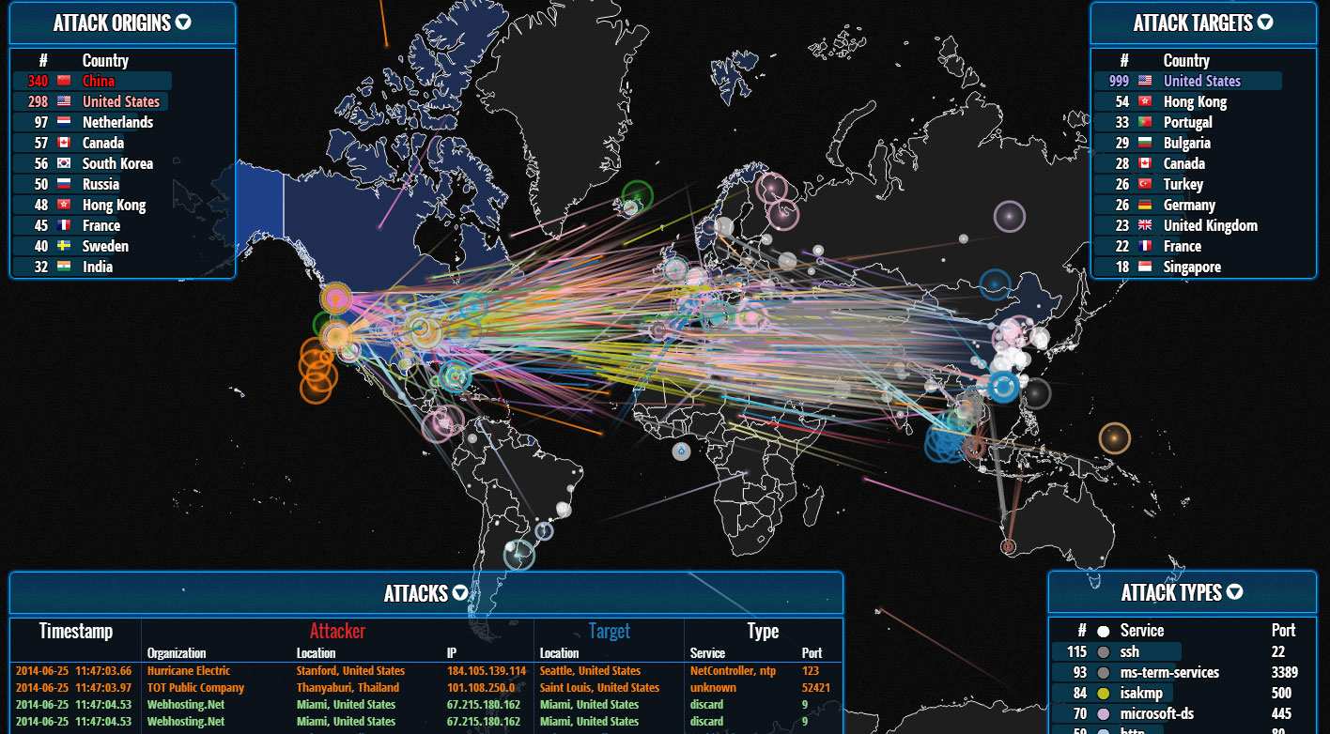
Notes:
Behind our mocking of this is that nobody can figure out what it does.

Slide 30
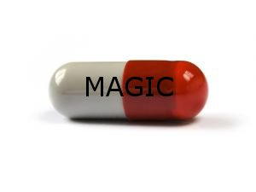
Trope: A magic pill will save you
Notes:
We know it’s wrong, but every conversation we have is warped into this.

Slide 31
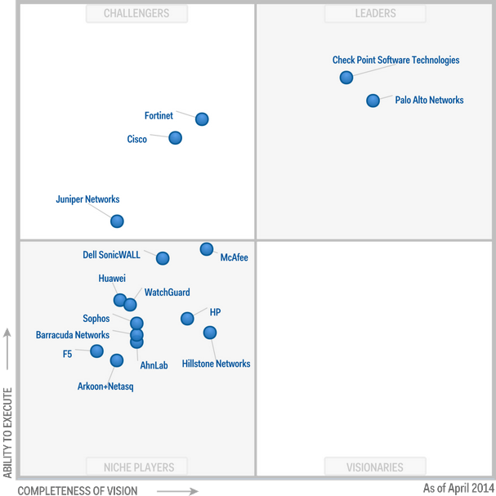
Gartner
“Ability to execute”
“Completeness of vision”
not
“How well it works”
Notes:
For example, Gartner Magic Quandrants are still relevant, no matter how much we fight this trope. No matter what we do, we can’t fight executives from buying magic pills.
Note that as far as Gartner is concerned, products work on “vision”. They don’t do technical evaluations if the products work. Indeed, they often don’t.

Slide 32
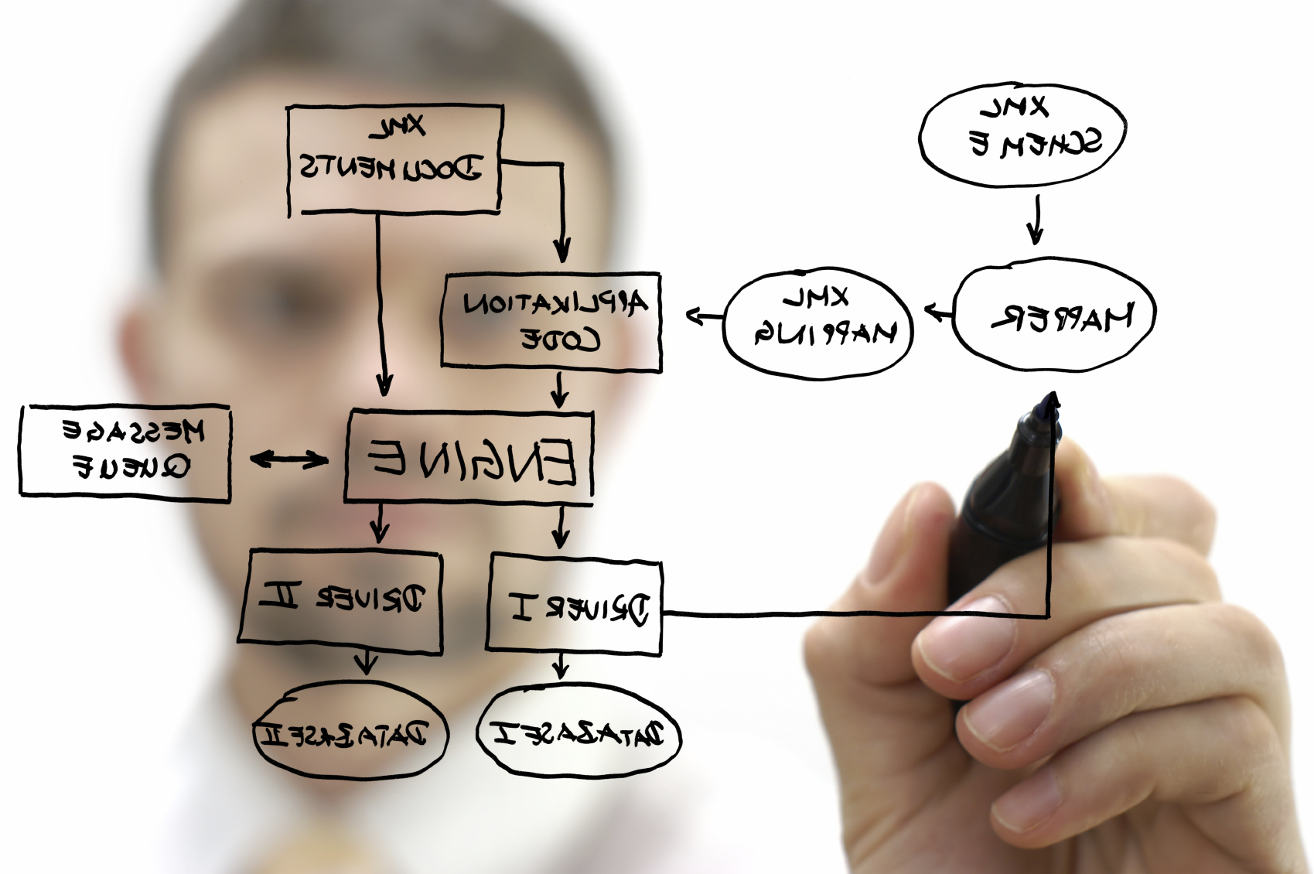
“Security is a process, not a product” -- Schneier
Notes:
Schneier fights this. But then he creates a wrong cliché of his own, saying that “security is a process”. That’s just another form of magic pill.
PCI is a process. How is that working out for you?
I get this conversation all the time:
“So how does your process handle SQL injection?”
“What’s that?”
Organizations have processes that never get around to details.

Slide 33
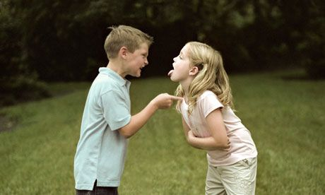
Trope: My pundit can beat up your pundit
Notes:
I hate going into meetings where some person keeps quoting pundits. It’s the weight of the pundit’s credibility that stands behind them.
…and they often get the pundit wrong.

Slide 34

Aphorisms and platitudes lost in translation
Notes:
Sun Tzu quotes are misattributed, changed, translated poorly, and used out of context. I’m not sure any is valid.

Slide 35
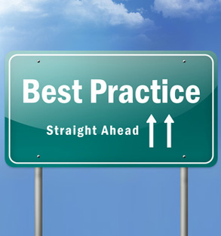
Best practices Just do the basics
Notes:
Everyone knows you should follow the basic best practices.
Nobody knows what they are. What are the best practices for solving SQL injection, password reuse, and most importantly, phishing?

Slide 36
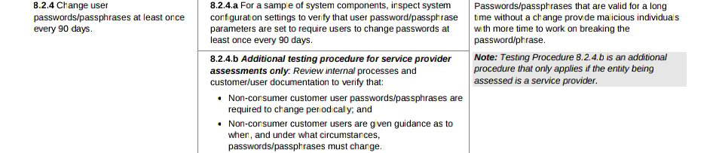
PCI: Change password every 90 days
from @csoghoian
Notes:
First, let’s deal with the PCI clichés.
“We are PCI compliant so can’t get hacked”
“If they got hacked, they were out of compliance”
Um, PCI is exactly “security is a process”.
Second, let’s look at this recommendation in particular. It tells organizations to force frequent password changes. This is repudiated by just about everyone. Yet, it persists, because it’s an easily understood “best practice” – even users know it.
It’s like “don’t open email from people you don’t know”. Irrelevent, because phishing comes from people you know, but people still follow this as a best practice.

Slide 37
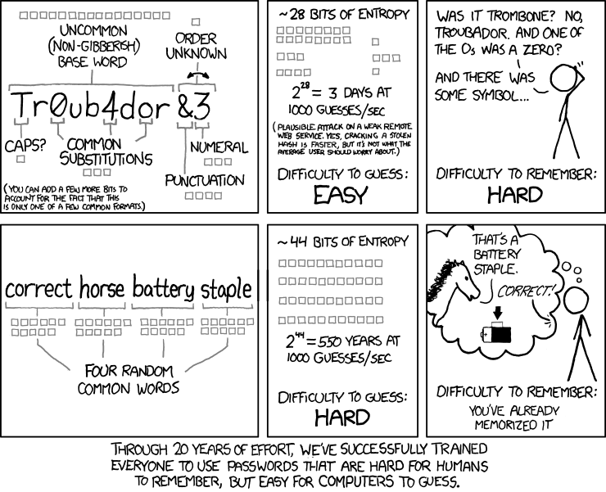
Notes:
Again, you should all know this XKCD. It shows how password best practices combine to make them useless.

Slide 38
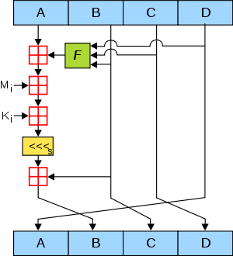
MD5 is broken, use SHA256
Notes:
No. MD5 is fine for certain things, especially anything password releated. It’s just broken for things like SSL Certificates.
Other related clichés: raindbow tables! Use salt!

Slide 39
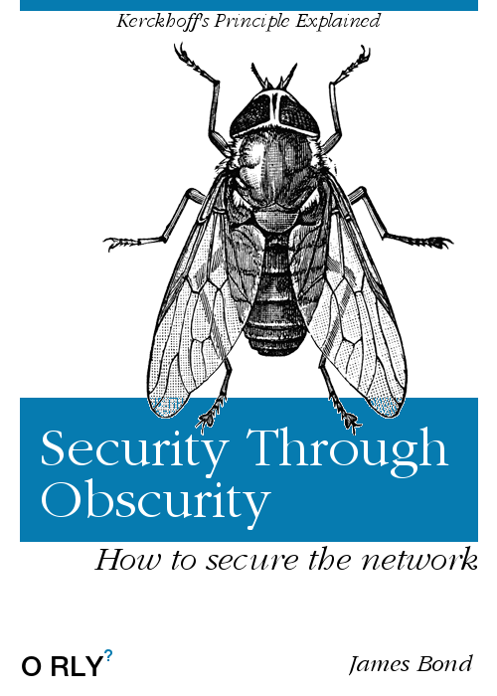
Notes:
Okay, I’ve got several follow-on slides for this cliché.

Slide 40
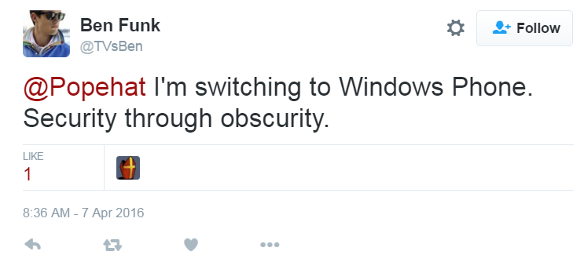
Some people really mean it They hear it so often, they forget why
Notes:
It gets repeated so often that people forget why. They begin to think it’s a good thing. If you search twitter, you’ll see many cases where people use it unironically as a good thing.

Slide 41
If it’s obscure, it’s “security through obscurity”
Change SSH to some other port than 22, just so your logs don’t fill up with all those password attempts.
Companies choose closed-source to make a profit.
Notes:
Yes, if you change your SSH port, it’ll make it hard for good vuln scanners to find it, which is an example of the cost of obscurity.
But no, the specific recommendation isn’t about security, it’s about avoiding filling up log files. Automated scanners hunt for port 22. If you don’t want this sort of thing filling your logs, move it to another port. If someone is guessing SSH passwords at port 3827, then you know they are probably targeting you specifically instead of masscanning you.
Or consider closed-source companies. They don’t close their source to make it more secure. They close their source to make a profit. It’s “Profit through obscurity”.

Slide 42
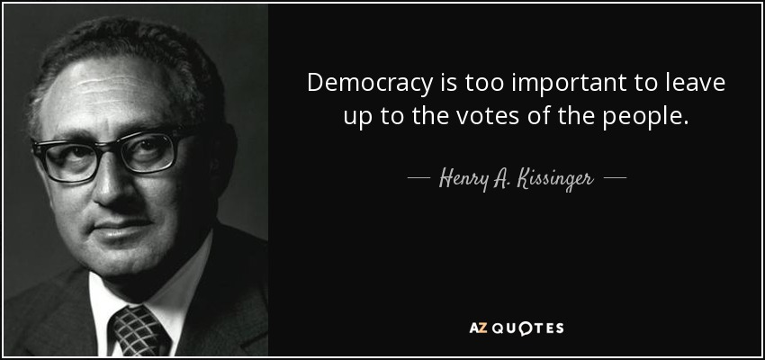
Good principle in general, but not for the important stuff.
Notes:
Finally, in regards to the Kerkhoff principle, it appears people don’t really believe in it. It’s a useful axe to grind against things you don’t like – but in your case, the thing you like, it’s too important to be left up to the invisible magic of Kerkhoff.

Slide 43
“Hacking back”
Add ‘webugs’ to .docx and .pdf to phone-home.
Massive DDoS against source of IDS events.
Notes:
This is a trope. We can’t discuss practical things with this trope reaching into our discussions and morphing them.
Everyone agrees adding webbugs to track documents is a good form of “hack back”.
Everyone agrees DDoSing the source of IDS events is a bad form of “hack back”.
When we argue about whether hack-back is good or bad, there’s good chance we are in complete agreement, except that you are using hack-back to refer to one and I’m using hack-back to refer to the other.
The point is: don’t use this cliché. Discuss what you mean instead.

Slide 44
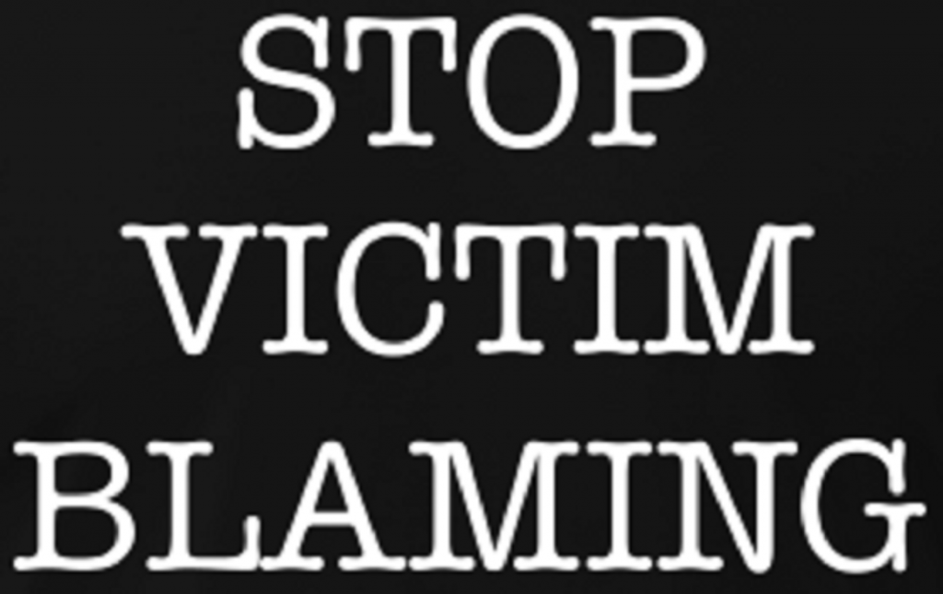
Victim blaming Victim shaming
Notes:
One of the problems with clichés/tropes is that some are too Holy to be touched. I’m not smart enough to avoid them, so I’ll delve in.
Not everything is victim blaming. Sometimes it’s just cause and effect. When I tell you “don’t the hot stove”, but you do anyway, I’m not blaming you or shaming you for immoral actions. I’m just pointing out cause and effect.

Slide 45
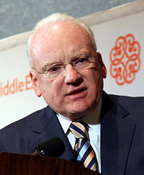
“If you spend more on coffee than on IT security, then you will be hacked. What's more, you deserve to be hacked.”
Notes:
But what is victim blaming is this quote from Richard Clarke, a well known “security homer” with not technical skills, but who claims much moral authority.
The goal is very much to blame you for your actions, and to shame you for you immorality. The goal is to punish you.
But when he says this, everyone in our community cheers. Nobody stands up and says “this is victim blaming”. It’s because the topic is about males.

Slide 46
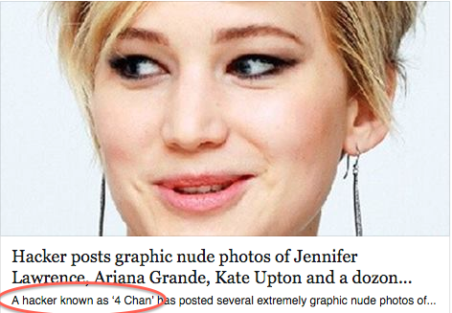
Celebrities shouldn’t take nude selfies, because their phones can’t be secured.
Notes:
As soon as the topic turns to females, then everything becomes victim blaming, even things that aren’t.
A couple years ago there was the “Fappening” incident where a guy used phishing to get into the phones of a hundred female celebrities and steal their nude selfies, which he then posted online.
The correct advice is that celebrities shouldn’t take nude selfies on the phone. It’s not a moral condemnation. Few of us think it’s moraly wrong. Instead, as experts, we know that there is really no way to protect phones from celebrity’s fans.

Slide 47
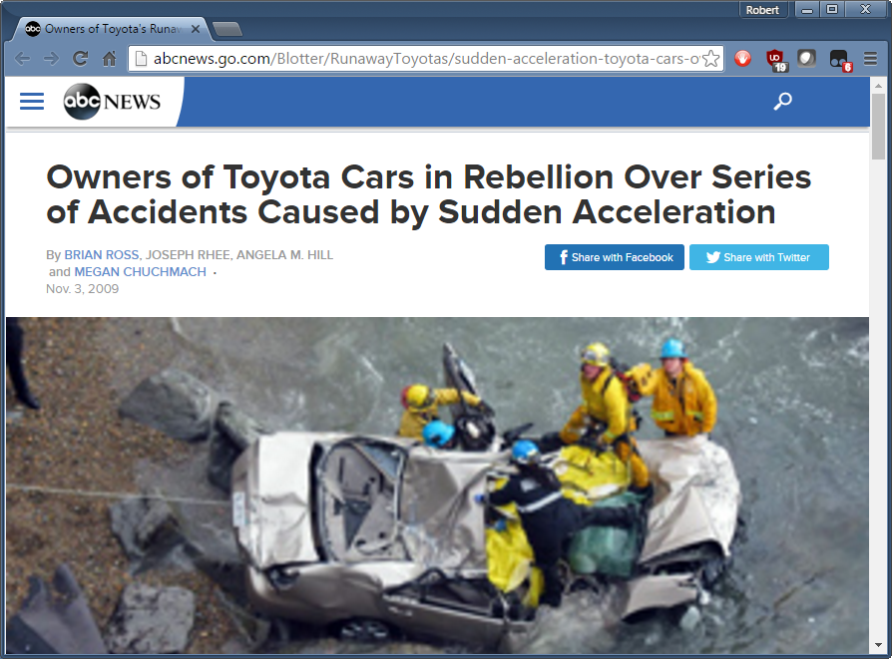
Notes:
In 2010, there was 2000 cases of “sudden acceleration” in Toyota cars, where the cars would accelerate out of control despite the drivers pressing hard on the brakes.
http://abcnews.go.com/Blotter/RunawayToyotas/sudden-acceleration-toyota-cars-owners-rebel-accidents/story?id=8980479

Slide 48
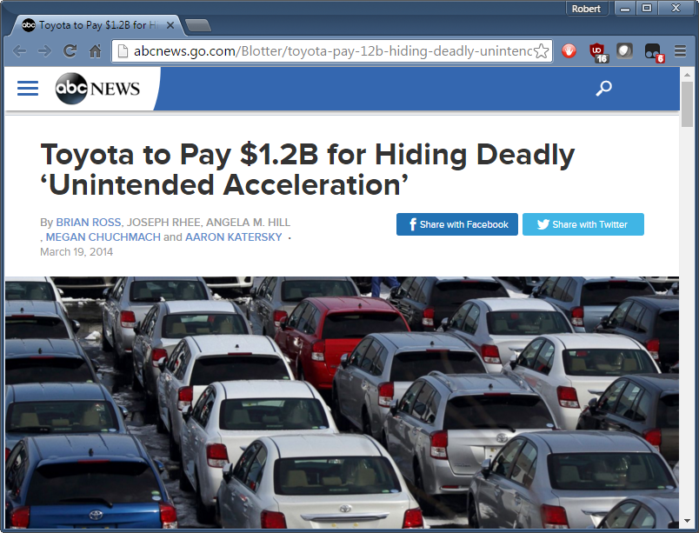
Notes:
Toyota spent billions on this in fines and court settlements.

Slide 49
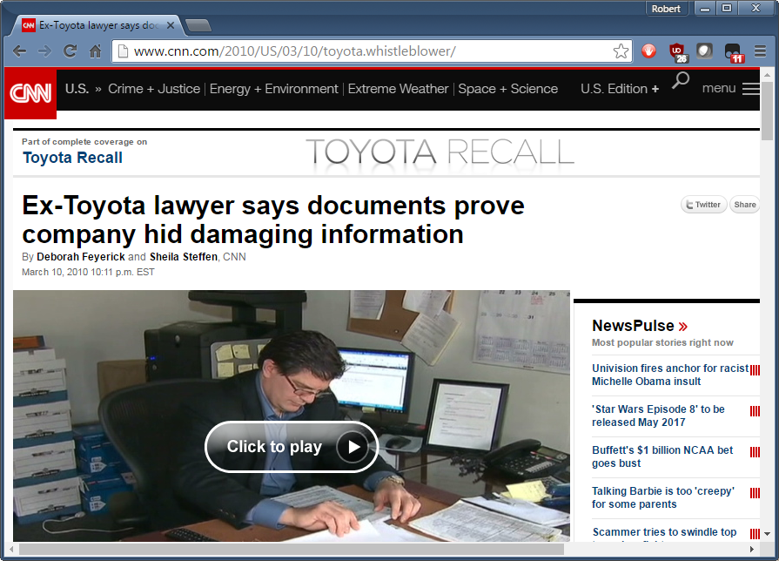
Notes:
It followed the trope that carmakers care more about profits than safety.

Slide 50
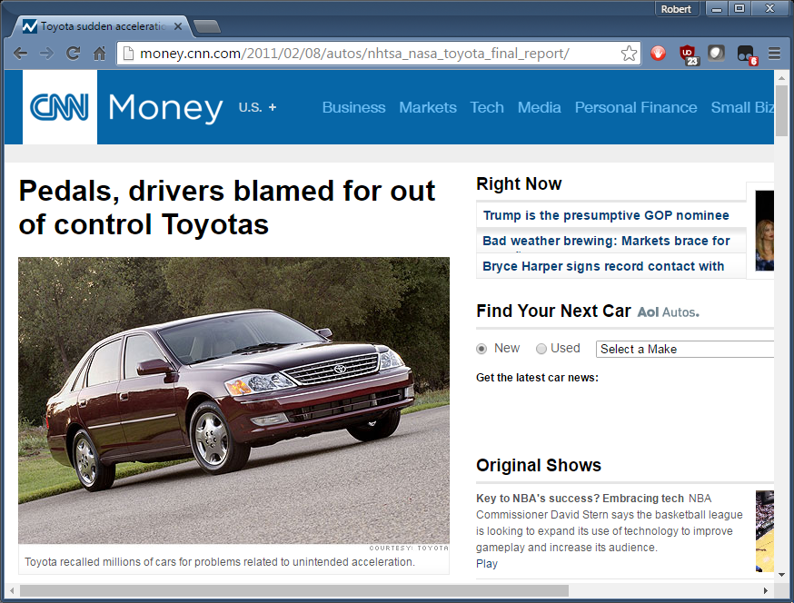
Notes:
But here’s the thing. It was all a lie, created by the power of that trope to alter people’s judgements.
NASA and the NHTSA studied the problem in depth. If you press the brakes as hard as drivers claim, it scares them in a noticeable way.
What they found is that in virtually all cases, it was “misapplication of pedal”. Confused drivers were pressing on the accelerator thinking it was the brake.
Toyota owners are mostly young, but those reporting the problem were mostly old.

Slide 51
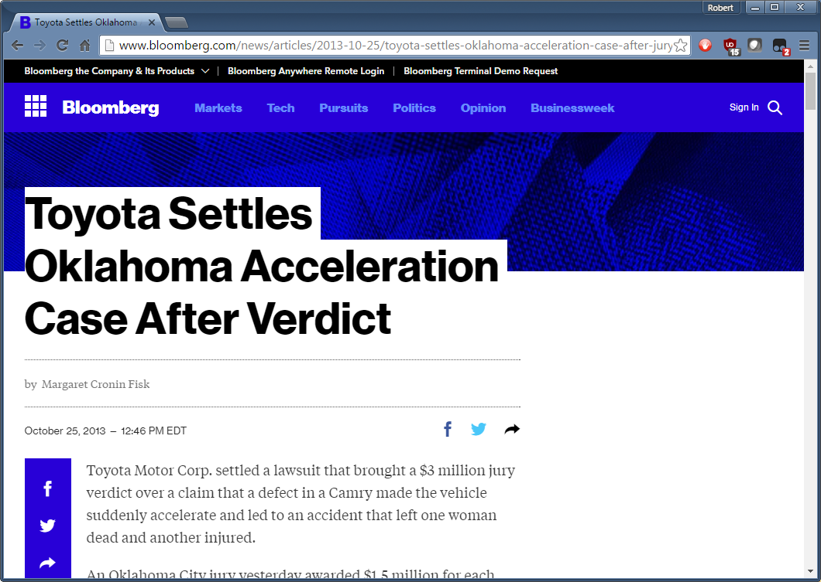
Notes:
What about the case where Toyota sellted for $3 million with Jean Bookout? Didn’t’ the expect witness prove the problem was in the control unit source code?
No, it was flim-flam. For one thing, much of the C source code is produced automatically by MathLab. Yes, it’s spahghetti code, but humans aren’t supposed to modify it.
Bookout was 76 years old. The reason for the acceleration was because she’s old and shouldn’t be driving. But nobody likes this trope, they prefer the car-company-doesn’t-care trope. And that’s what the truth becomes, regardless of the evidence.

Slide 52
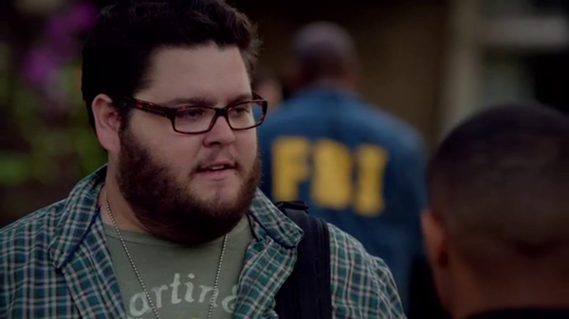
Notes:
Now for some fun things: clichés/tropes in TV/movies, like CSI:Cyber.
“best white hat hacker in the world”

Slide 53
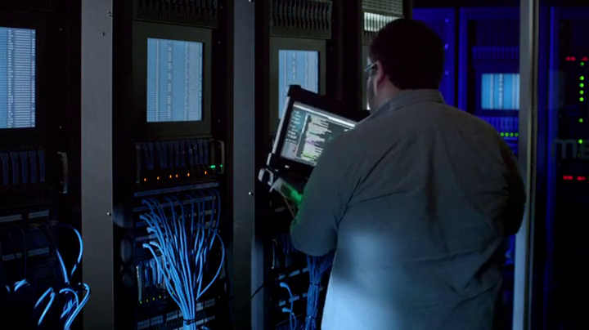
Notes:
Things have to take place in the server room, even things better done with a table and chair, such as source code review.

Slide 54
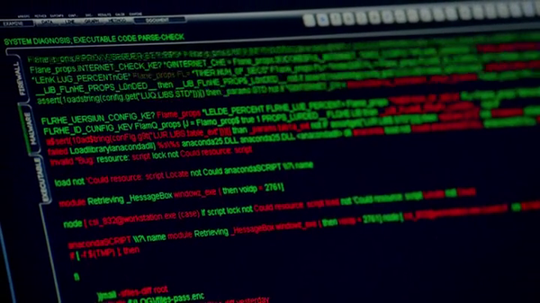
Notes:
Because virus code is red, and good code is green

Slide 55
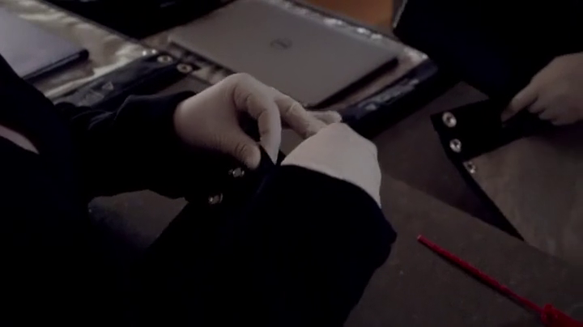
Notes:
Faraday bags are like a lead vault.

Slide 56
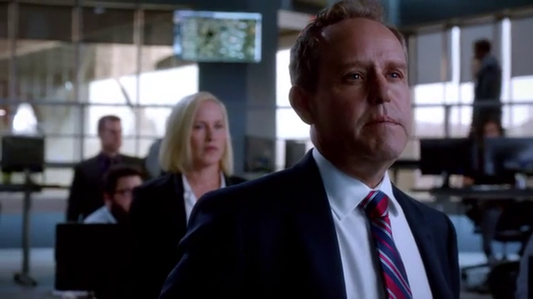
Notes:
“The very thing you got to protect your baby ends up hurting it”

Slide 57
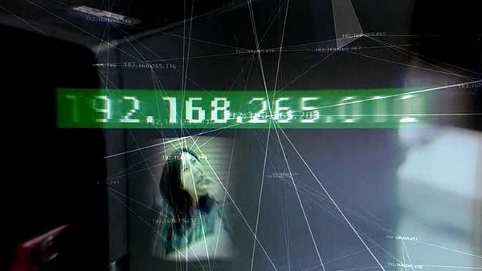
Notes:
192.168 is already like a 555 phone number. No need to obfuscate it further.

Slide 58
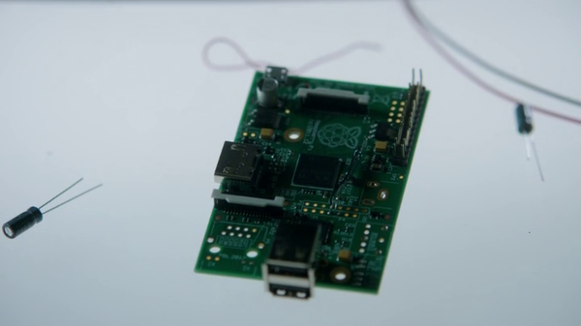
Notes:
“This board was the weapon”.
Obviously, keep away from children.

Slide 59
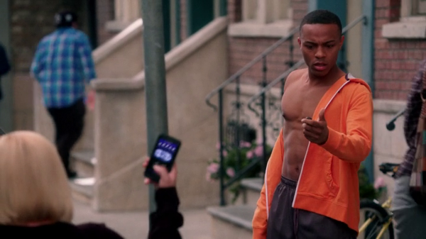
Notes:
In this scene, she hacks the car, to remotely trigger the car alarm, to wake him up and get him out of the building. But she triggers it while sitting on the car – a physical nudge would trigger the alarm anyway.

Slide 60
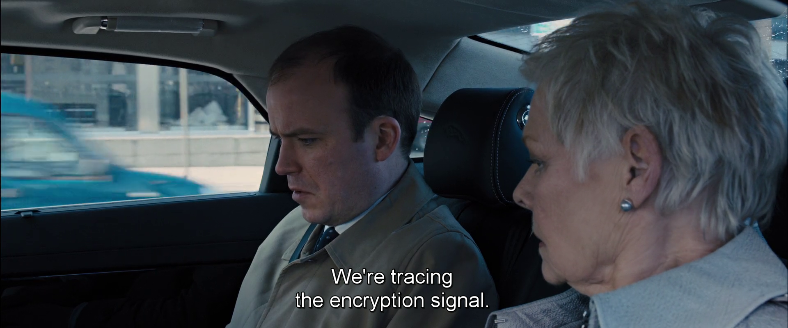

Slide 61
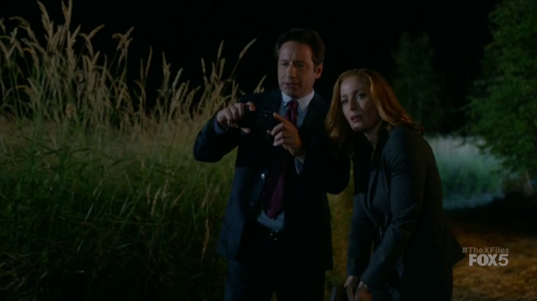
Notes:
This is the best trope of them all. When the X-Files came out, they didn’t have cameras. They saw lots of stuff, but nobody would believe them without photographic evidence.
In the reboot, they now have cameras.
The iPhone, of course, is proof of the lack of UFOs and bigfoot. There are so many cameras everwhere now, surely somebody would’ve gotten a picture.

Slide 62
fin

